Slide 1
Centerpointe Research Institute and Bill Harris present:
New Brain Science Discoveries That Will Change Your Life!
By Changing Your Brain, You Can Create Astonishing Levels of:
Awareness
Willpower
Happiness
Emotional Resilience
Creativity
Motivation
Focused Achievement
Flow
Much more!

Slide 2
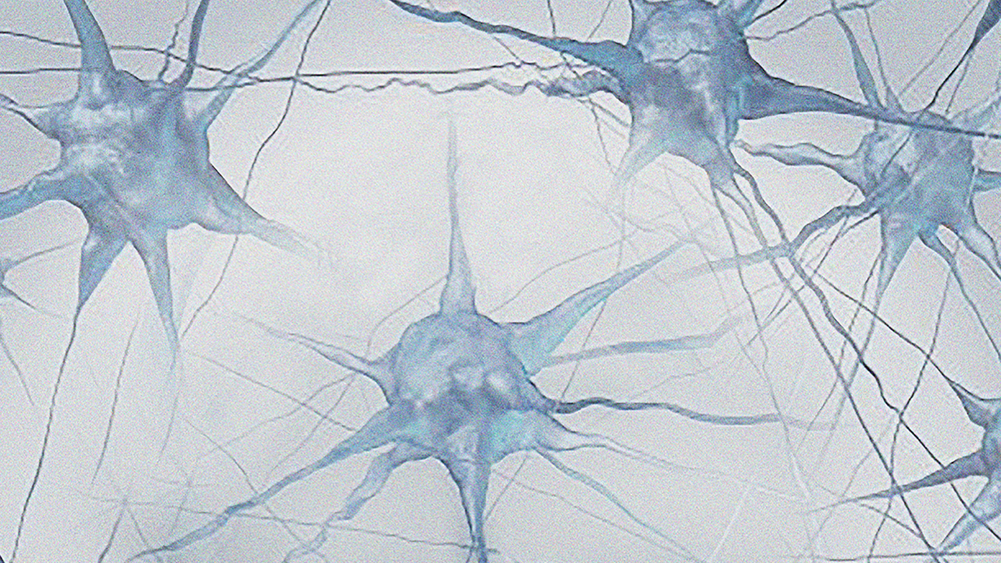
I’m going to share several new scientific discoveries that will allow you to...
….have more of the personal qualities you admire:
Creativity
Courage
Motivation
Confidence
Willpower
Great decisions
Persistence
Kindness
Compassion
Patience
Charisma

Slide 3
I’m going to share several new scientific discoveries that will allow you to...
….get rid of negative thinking, feelings, behaviors, and qualities that have held you back:
Anxiety
Fear
Reactivity
Brain fog
Confusion
Procrastination
Bad habits
Bad decisions
Self-sabotage

Slide 4
When your brain works right, implementing what you learn and following through becomes easy.

Slide 5
The real reason why what you’ve tried hasn’t worked that well:
Most approaches address symptoms, not fundamentals.
Today, we will address the fundamentals.

Slide 6
FREE BONUS for sticking around to the end:
$299.00 video course: Harnessing the Power of Awareness
Optimizing your brain creates awareness
With enough awareness, you see how you create your:
Feelings
Behaviors
Which people and situations you attract or become attracted to
What meanings you assign to what happens
With awareness, these four things become a choice.
Once you have a choice you’ll always choose what serves you.

Slide 7
What will your life be like when you change your brain?
You’ll remain calm…
When criticized or disappointed
When you don’t get what you want
What if you could feel good in any situation – while doing whatever is necessary to improve it?

Slide 8
What will your life be like when you change your brain?
What if you knew just what to say… To your romantic partner? Your children? Your coworkers?
You’d have fewer misunderstandings.
Others will be motivated to be kind to you!

Slide 9
What will your life be like when
you change your brain?
What if creative ideas popped into your head in any difficult situation?
This will happen when you optimize your brain!

Slide 10
3 Paradigm-changing Scientific Discoveries
#1 The Genesis Discovery
Everything comes from your brain
Abilities
Talents
Skills
Personal Qualities
Negative Thoughts, Feelings, and Behaviors
Because everything comes from your brain…
...changing your brain changes everything, at the most fundamental level.

Slide 11
3 Paradigm-changing Scientific Discoveries
#1 The Genesis Discovery
Everything comes from your brain
#2 The Brain Map Discovery
Scientists also know which parts of your brain create
The qualities and abilities you want more of
The negatives you want to get rid of

Slide 12
3 Paradigm-changing Scientific Discoveries
#1 The Genesis Discovery
Everything comes from your brain
#2 The Brain Map Discovery (“Google Maps for your brain”)
The qualities and abilities you want more of
#3 The “Change Your Brain and Keep the Change” Discovery
Scientists know how to change the parts of the brain you need to change

Slide 13
Discovery #1: The Genesis Discovery
Everything about you comes from your brain:
Moods
Emotional responses
Skills and talents
Happiness
Whether you’re anxious or calm
Whether your relationships are easy or difficult
How much willpower you have
Your financial success
And everything else

Slide 14
Discovery #1: The Genesis Discovery
All these things are a reflection of the health of your brain.
This is a new way of looking at your life!
It isn’t a matter of “what you were born with” – or if you’re trying hard enough.

Slide 15
The BIG Takeaway:
The difference between you and the person with the desirable qualities you want is that…
...their brain is working better than yours!
Which you can change!

Slide 16
Discovery #2: The Brain Map Discovery
Scientist know what parts of your brain create…
The positive, desirable qualities you want more of
The negatives you want to get rid of
There’s a war going on in your brain –
and most people are losing!

Slide 17
Discovery #3: Change Your Brain and Keep the Change
One big underlying premise: Your brain can change.
This is a revolutionary discovery!
Now we can create changes once
thought to be impossible!

Slide 18
Calming Your Limbic System and Enhancing Your Prefrontal Cortex (Here’s how to do it…)
#1 Turn Down Your Stress
Stress is the biggest cause of an overactive limbic system…
...and a weak prefrontal cortex.

Slide 19
Calming Your Limbic System and Enhancing Your Prefrontal Cortex (Here’s how to do it…)
#1 Turn Down Your Stress
#2 Take brain supplements
Supplements can calm the limbic system and enhance the prefrontal cortex.

Slide 20
Calming Your Limbic System and Enhancing Your Prefrontal Cortex (Here’s how to do it…)
#1 Turn Down Your Stress
#2 Take brain supplements
#3 Use breathing exercises
Breathing exercises can calm the limbic system.

Slide 21
Calming Your Limbic System and Enhancing Your Prefrontal Cortex (Here’s how to do it…)
#1 Turn Down Your Stress
#2 Take brain supplements
#3 Use breathing exercises
#4 Eat the right diet
The right diet can help calm your limbic system and enhance your prefrontal cortex.

Slide 22
Calming Your Limbic System and Enhancing Your Prefrontal Cortex (Here’s how to do it…)
#1 Turn Down Your Stress
#2 Take brain supplements
#3 Use breathing exercises
#4 Eat the right diet
#5 Regular exercise
Exercise calms the limbic system and enhances the prefrontal cortex

Slide 23
But here’s THE most effective way to calm your limbic system and enhance your prefrontal cortex...
Meditation
A mountain of research shows that regular meditation powerfully calms the prefrontal cortex and enhances the prefrontal cortex!

Slide 24
There’s one big problem with meditation...
Hardly anyone will actually do it!
Hard to learn
Long learning curve
A long wait for results
Most people quit before they see significant results!

Slide 25
So what’s the solution?
Holosync® audio technology
Holosync® is a technological method for:
Changing your brain
Calming your limbic system
Enhancing your prefrontal cortex
Effortlessly making the beneficial brainwave patterns of a 30-year veteran meditator

Slide 26
So what’s the solution?
Technology makes everything easier...
Cars are easier and faster than walking
Email is easier and faster than snail mail
A keyboard is easier and faster than a pen
And Holosync® is easier and faster than traditional meditation

Slide 27
Holosync® is technological meditation!
A proven method
Based on research at the Menninger Clinic, Mt. Sinai Medical Center, Harvard, and other research facilities
Easily creates all the brain changes we’ve discussed
It’s effortless. All you do is listen!
Holosync isn’t new
Tested and proven by over 2.2 million people over 3 decades
Endorsed by hundreds of prominent personal growth teachers, doctors, therapists, and thought leaders.

Slide 28
Q: What do you know NOW, that you didn’t know when we first started?
Three revolutionary discoveries:
#1 Everything comes from your brain
#2 We know what parts of your brain create what you want and what you want to get rid of
#3 We now know how to change those parts of the brain
Supplements, breathing exercises, diet, exercise
Meditation
Holosync (8x faster than traditional meditation!)

Slide 29
Holosync will change your brain
It will calm your limbic system (the source of the negatives you want to eliminate)
It will enhance your prefrontal cortex (source of the positives you want to increase)
It will train your brain to make the beneficial brain wave patterns that allow access to the beneficial qualities you want

Slide 30
What would Holosync mean to your life?
More peace of mind
Greater happiness
More confidence
Greater motivation
Improved relationships
More effectiveness
A greater ability to love and be loved
Greater productivity
Get what you want in your life

Slide 31
What problems would you avoid with a calm limbic system?
Less emotional reactivity
Fewer bad feelings
Not always needing to be “right”
Eliminate food problems
Keep your lifestyle resolutions
Achieve your goals
Follow through on exercising
Finish what you start
Feel less overwhelm

Slide 32
What problems would you avoid with a calm limbic system?
Avoid bad feelings
Save time and money by making better decisions
Better relationships
Be more creative
Easily bounce back from setbacks
Be more likable

Slide 33
Let’s talk about you...
You know that changing your brain will change your entire life
You have something important to do with your life
You have people to love and something to create
You want more happiness, peace, productivity, success
You want to leave behind hurts, negative feelings, limiting beliefs, insecurities
You want to get out of bed every day happy to be alive

Slide 34
Holosync® isn’t for dabblers
Holosync is for people who want huge positive changes in:
Mental health
Emotional health
Spiritual health
Physical health
It’s for those who’ve tried everything and want something that (finally) really works.

Slide 35
So what’s the catch?
Using Holosync is a lifestyle change (one you’ll love, though)
You must use it!
Just put on your headphones, push play, and listen. Holosync does all the work.
Don’t have time? There’s a way to listen to Holosync without taking a single minute out of your day.

Slide 36
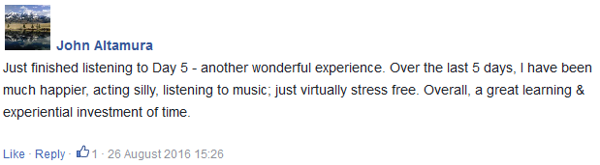
Initial reports from new Holosync users:

Slide 37
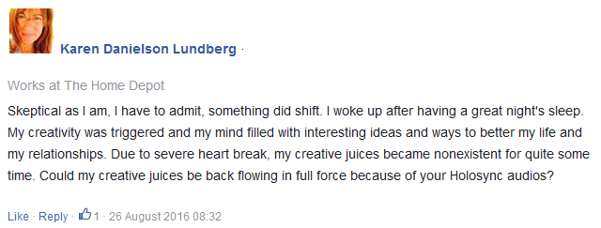
Initial reports from new Holosync users:

Slide 38
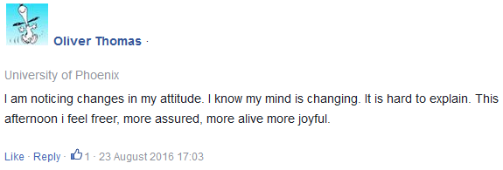
Initial reports from new Holosync users:

Slide 39
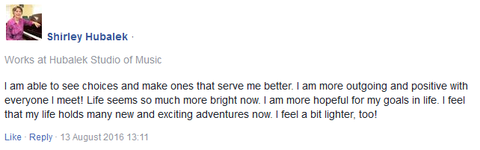
Initial reports from new Holosync users:

Slide 40
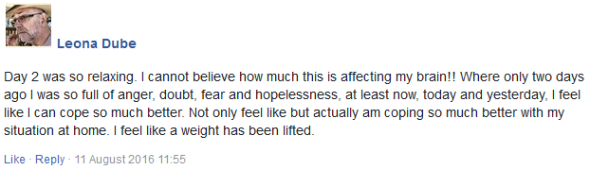
Initial reports from new Holosync users:

Slide 41

You get:
Full Awakening Prologue package – CDs or downloadable MP3s
Create powerful brain changes
Calm your limbic system
Enhance your prefrontal cortex
Synchronize L&R brain hemispheres
Teach yourself to access beneficial brainwave patterns
$179.00 value
The Dive (Holosync soundtrack)
Immersion (Holosync soundtrack)
Your Unfair Advantage: An Introduction to Holosync (Holosync soundtrack with information)
Full Instructions
Introductory Written Materials Total value = $179.00

Slide 42
You get:
Full Awakening Prologue package
A Better Brain, A Better Life: The Holosync Users’ Guide to Super Awareness 6-video set
$397.00 value
Special 6-video series:
Increase motivation and follow-through
Avoid misconceptions, pitfalls, getting off track
Fully understand the process
More easily get all Holosync benefits
Learn from the experiences and mistakes of others
Total value = $576.00

Slide 43
You get:
Full Awakening Prologue package – CDs or downloadable MP3s
A Better Brain, A Better Life: The Holosync Users’ Guide to Super Awareness 6-video set
Unlimited access to Centerpointe Accelerated Results Coaches
$1,200.00 value (at least)!
Someone you can discuss your experiences with
Instant answers to your questions
High-touch expert mentoring
Great customer service
Fast problem solutions
Total value = $1,776.00 Discounted price: $259 (CDs) $239 (MP3)

Slide 44
You get:
Full Awakening Prologue package – CDs or downloadable MP3s
A Better Brain, A Better Life: The Holosync Users’ Guide to Super Awareness 6-video set
Unlimited access to Centerpointe Accelerated Results Coaches
5 additional A Better Brain, A Better Life videos
$297.00 value
More easily get all Holosync benefits
Increase motivation and follow-through
Avoid misconceptions, pitfalls, getting off track
Fully understand the process
More easily integrate the brain changes you’ll experience
Total value = $2,073.00 Discounted price: $259 (CDs) $239 (MP3)

Slide 45
You get:
Full Awakening Prologue package
A Better Brain, A Better Life 6-video set
Access to Centerpointe Accelerated Results Coaches
5 additional A Better Brain, A Better Life videos
Inside Secrets of How to be Happy, Peaceful, and Successful All the Time (live retreat talks)
$297.00 value
Key principles to enhance your life
Yours on a handy flash drive
7 hours of live Retreat Talks
Spontaneous back and forth with a live audience
Others paid over $2,000 to attend
Total value = $2,370.00 Discounted price: $259 (CDs) $239 (MP3)

Slide 46

You get:
Full Awakening Prologue package
A Better Brain, A Better Life 6-video set
Access to Centerpointe Accelerated Results Coaches
5 additional A Better Brain, A Better Life videos
Inside Secrets of How to be Happy, Peaceful, and Successful All the Time (live retreat talks)
PLUS: Full One-Year, 365 Day, No-Questions-Asked Money-Back Guarantee!
An entire year to evaluate Awakening Prologue and still get your money back
“No-Questions-Asked” Money-Back Guarantee
Lowest refund rate in the personal growth industry
Total value = $2,370.00 Discounted price: $259 (CDs) $239 (MP3)

Slide 47
You get:
Full Awakening Prologue package
A Better Brain, A Better Life 6-video set
Access to Centerpointe Accelerated Results Coaches
5 additional A Better Brain, A Better Life videos
Inside Secrets (live retreat talks)
PLUS: Full One-Year, 365 Day Money-Back Guarantee!
NEW ADDITIONAL BONUS:
Holosync Brain Club FREE 3 month membership
$3,655.00 Value
3 months FREE ($291 value)
Monthly Coaching calls ($360 value)
Annual Live Brain Club event + VIP reception ($2,000 value)
FREE monthly supplement ($180 value)
Brain Club online group ($97 value)
Weekly 5-Minute Brain inspiration Videos
Holosync Brain Club Book Circle
10% discount on ALL Centerpointe products (Thousands of $$ value)
Brain Resource Vault ($750 value)
No price increase, ever
Total value = $6,100.00 Discounted price: $259 (CDs) $239 (MP3)

Slide 48


Slide 49
Full Awakening Prologue package
A Better Brain, A Better Life 6-video set
Access to Centerpointe Accelerated Results Coaches
5 additional A Better Brain, A Better Life videos
Inside Secrets (live retreat talks)
PLUS: Full One-Year, 365 Day Money-Back Guarantee!
NEW ADDITIONAL BONUS:
Holosync Brain Club FREE 3 month membership
$3,655.00 Value
Total value = $6,100.00 Discounted price: $259 (CDs) $239 (MP3)

